Slide 1
Leading a Successful Change Initiative
Library Management Institute
June 2014

Slide 4
Your change champions

Slide 5
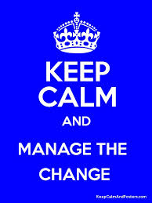

Slide 6
DPW Vision
Three Guiding Principles
Customer service
Make changes that improve customer service
Results matter
Three Areas of Focus
Services and expertise
Knowledge resources
Library spaces
Notes:
If you attended the first Library Town Hall meeting after I arrived, you may remember that I described my three guiding principles: that service is the most important perspective, that we should make changes that improve customer service, and that above all, results matter. I’ve also identified three broad areas of focus: …

Slide 7
Establish a sense of urgency about the need to achieve change
“Due to new leadership and the formulation of strategic goals, it has been determined there is an opportunity to have a more efficient structure to support those goals. This, coupled with many voluntary retirements through the
Staff Voluntary Early Retirement Incentive Plan (SVERIP), and additional faculty retirements, provides an opportunity to increase organizational effectiveness,
efficiency and job satisfaction at the Hesburgh Libraries.”
OAD Business Case Statement

Slide 8
Guiding principles of the oad

Slide 9
Create a Guiding Coalition
Create change team of 6-8 people from throughout the organization
Members who are respected and trusted by their colleagues as individuals who will represent interests across the Libraries honestly
Members who will bring the perspective of their unit, but are also able to focus on the Library as a whole
★Player’s Coach
Assemble a group with power energy and influence in the organization to lead the change.

Slide 10
Develop a vision and strategy specific to the change

Slide 11
February: Gather data, benchmarking from internal and external sources
March: begin high-level design thinking, listening sessions, talent survey
April: present high-level design, begin thinking about expectations, processes and relationships
May: Mid-level options and expectations, unit-level options and expectations
June: Implementation Plan

Slide 12
“Overall organizational design that reflects our strategic goals and the University priorities”

Slide 13
Aligning with ND Goals
Library Goal | University Goal
Advance research & scholarship | Become a preeminent research university
Enrich educational experience & intellectual growth | Offer an unsurpassed undergraduate education
Heighten the value and impact of the Libraries by developing digital programs & services | Become a preeminent research university
Transform library spaces to foster and inspire intellectual engagement | Preeminent research university Unsurpassed education Service excellence
Create a sustainable culture of continuous improvement and service excellence in support of the University’s mission | Create a sustainable culture of continuous improvement and service excellence Communicate strategically to internal and external constituents

Slide 14
INPUT
Held 14 listening sessions, held 3 break briefings, 2 Town Hall meetings
Gathered & reviewed information from faculty, students, & campus administrators
Reviewed organizational charts from more than 20 organizations
Reviewed articles on reorganization of libraries and organizational chart designs
Marcy served as Player’s Coach
HRC brought advice from Linkage consultant
Staff Think Tank Team
Staff Think Tank Team anonymous form
Informal one-on-one’s
Campus guidelines for organization design

Slide 15
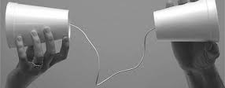
What We Heard:
Create meaningful positions
Increase organizational flexibility
Improve high level leadership
Clarify responsibilities
Eliminate silos
Focus on aligning with campus goals
Reflect campus values
Use our resources wisely
Manage the library effectively
Empower individuals and teams

Slide 16
Incorporate employee interests into new placements
Describe the ideal position that you feel will use your talents and provide a meaningful work experience for you. This can be the position you are already in or something else.

Slide 17
University Librarian
Leadership
Communications Program Director
Discovery Services & Digital Access
Research Services & Learning Resources
Administration, Organizational Development & Central Services
Management and
Team Leaders
…
Information Technology and Discovery Services
Digital Library Initiatives and Scholarship
Resource Acquisitions and Delivery
Outreach and Academic Engagement
Science, Engineering, Social Sciences, Business Research Services
Arts & Humanities Research Services
…
Supervisors and
Individual Contributors
To be determined. Reporting to management level.

Slide 18
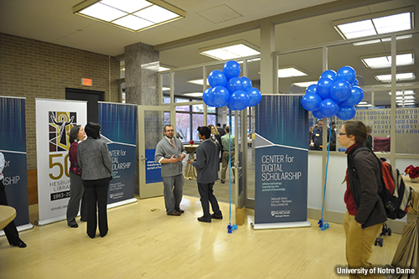
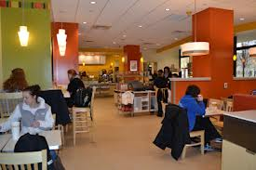
Recommend space to facilitate intellectual collaboration

Slide 19
Demonstrate how the libraries contribute to university goals in a way that is clear to those outside the libraries as well as library faculty and staff at all levels
Please rate your OVERALL satisfaction with the Hesburgh Libraries (excluding the Law Library): 8.51 2013 Improve ND Survey

Slide 20
Leadership
University Librarian
Special Projects
Empower leaders to initiate change and make decisions
Digital Access, Resources, and Information Technology
Research and Learning Services
Management
Administration, Organizational Development, and Central Services
Monitors
Development
Assessment
Building Services
Graphic Designer
Communications Program Director
Finance & Budget
Personnel Services
Organizational Development
Information Technology and Discovery Services
Digital Library Initiatives and Scholarship
Resource Acquisitions and Delivery
Outreach and Academic Engagement
Science, Engineering, Social Sciences, Business Research Services
Arts & Humanities Research Services
Web
Information Technology Systems
Desktop Computing & Network Services
Digital Library Services
Digital Production
Catholic Portal
Art Image Library
Scholars’ Lab
Copyright & Scholarly Communication
Acquisitions
CADM
Cataloging & Metadata
Electronic Resources
GovDocs
Current Periodicals & Microtext
Licensing
Gifts
Reference
First Year of Studies
Instruction
Instructional Designer
Outreach
Learning Commons
Delivery Services:
ILL, DocDel, Stacks, Circ,
Reserves, Mailroom
Humanities
Preservation
Special Collections
Architecture
Area & Region Studies
Fine Arts
Related Branches
Music & Media Services
Engineering
Sciences
Social Sciences
Business
Related Branches
Data Services

Slide 21
Use expectations to assess outcomes and evaluate the change process
Overall, how satisfied are you with the outcomes of the new organizational design?

Slide 22
Dissatisfied, what would change your satisfaction rating:
Satisfied/Very Satisfied
Easier to communicate between departments. Departments seem to be interconnected now; not as disjointed.
more progress towards goals of collaboration, removing silos, and transparency
Communication between departments and library groups is much better than it used to be.
I think increased mentoring would be good
Perhaps a quick reference guide to which unit does what, a sort of cheat sheet.
We are able to make positive changes and create more team oriented approach in my units by doing cross training and expanding staff expertise. Although there is additional work to be done, the first 15 months have had more positive than negative.
While I think there have been some success stories for particular individuals who were able to make changes that were good for them and the Libraries, overall I don't see evidence of significant gains in efficiencies or productivity or improved services that justify all the time and effort it took.
“I think the organization is functioning more effectively, and we have a better focus on shared strategic goals and priorities that move the Libraries forward in support of the University's strategic goals.”
My supervisor does a great job in leadership and my role change has contributed to some of the successes of the library.

Slide 23
SAMPLE RECOMMENDATIONS FROM ASSESSMENTS
Create a staff development program to strengthen our leadership capacity for achieving strategic initiatives, managing projects, expanding strengths and developing new ones.
Hiring priorities are now determined on a quarterly basis in February / June / November. As decisions are made each quarter, share hiring priorities and approved positions.
Replace ULONs with new, clear channels for communication of vital information
Ask Program Directors to work with their managers and supervisors to find the gaps in tasks that are going undone as a result of unmet staffing needs.

Slide 24
Keep repeating change WILL happen because change is necessary.

Slide 25
Don’t be afraid to challenge the naysayers
Signal vs. noise

Slide 26
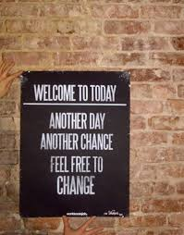

Slide 27
Recognize and champion the change agents who will help you lead

Slide 28
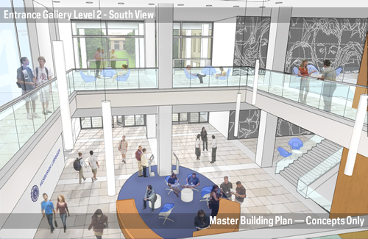
Without our reorganization…
Improve ND results
Offered 42 employees an opportunity to do something different
Infused $30,000 into targeted training efforts
Created shared understanding around our mission of Connecting People to Knowledge
Launched a successful year-long 50th Anniversary celebration that included a TEDX event
http://50years.library.nd.edu/

Slide 29
references
Photos from unsplash.com
Recommended Reading:
Anything by John Kotter for change management
Kűbler-Ross 5 stages of grief model
Six Sigma Green Belt (continuous improvement process)
50years.library.nd.edu

Slide 30
Thank you
Marcy Simons
Organizational Development Librarian
University of Notre Dame
223 Hesburgh Library
msimons@nd.edu
574-631-2871

